Slide 1
THEEKKARDO
VEHICLE ASSISTANCE AND MAINTENANCE SERVICE
AAMNA SAEED
BY:
TASHFEEN HASSAN
MESAM-E-TAMAAR

Slide 2
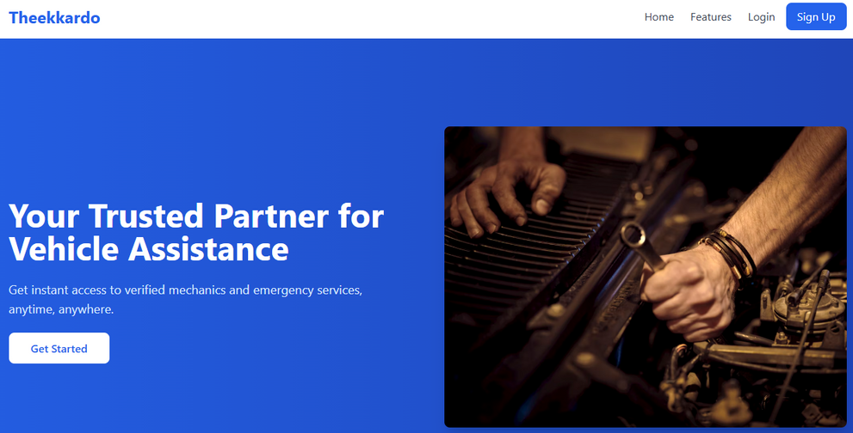
INTRODUCTION OF THE SYSTEM
TheekKardo is a web-based platform connecting vehicle owners with nearby mechanics for emergency repairs, maintenance, and washing services.
Features: service scheduling, real time location based requests, user ratings. The goal is to
Reduce stress during breakdowns
Simplify service scheduling and payments
Ensure transparency via reviews

Slide 3
ARCHITECTURE
Design Principles:
RESTful API architecture
Modular structure using MVC pattern
Secured using JWT for authentication
The application follows a Layered architecture model
LAYER 1
LAYER 2
LAYER 3
PRESENTATION LAYER
APPLICATION LAYER
DATA LAYER
BUILT USING REACT.JS, PROVIDES UI FOR USERS, MECHANICS, AND ADMINS.
BUILT USING NODE.JS (EXPRESS.JS), HANDLES BUSINESS LOGIC, API ENDPOINTS.
BUILT ON MONGODB ATLAS TO LEVERAGE CLOUD STORAGE AND NOSQL DATA STORAGE

Slide 4
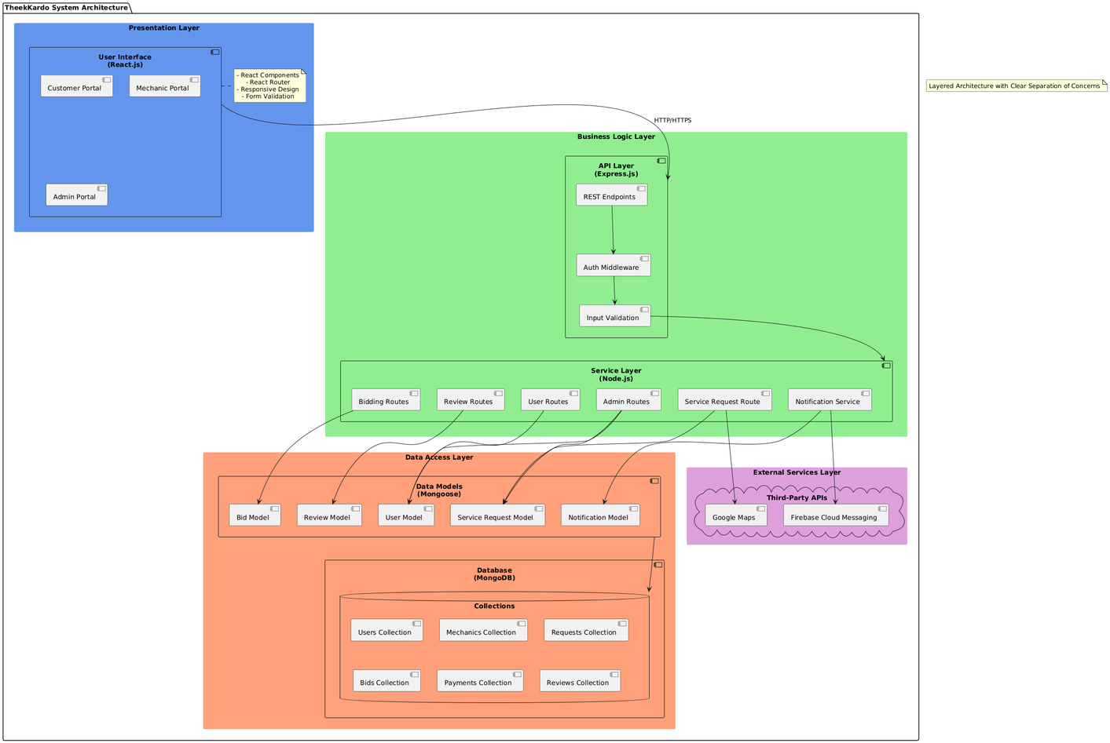
UML DIAGRAMS
Architecture Diagram

Slide 5
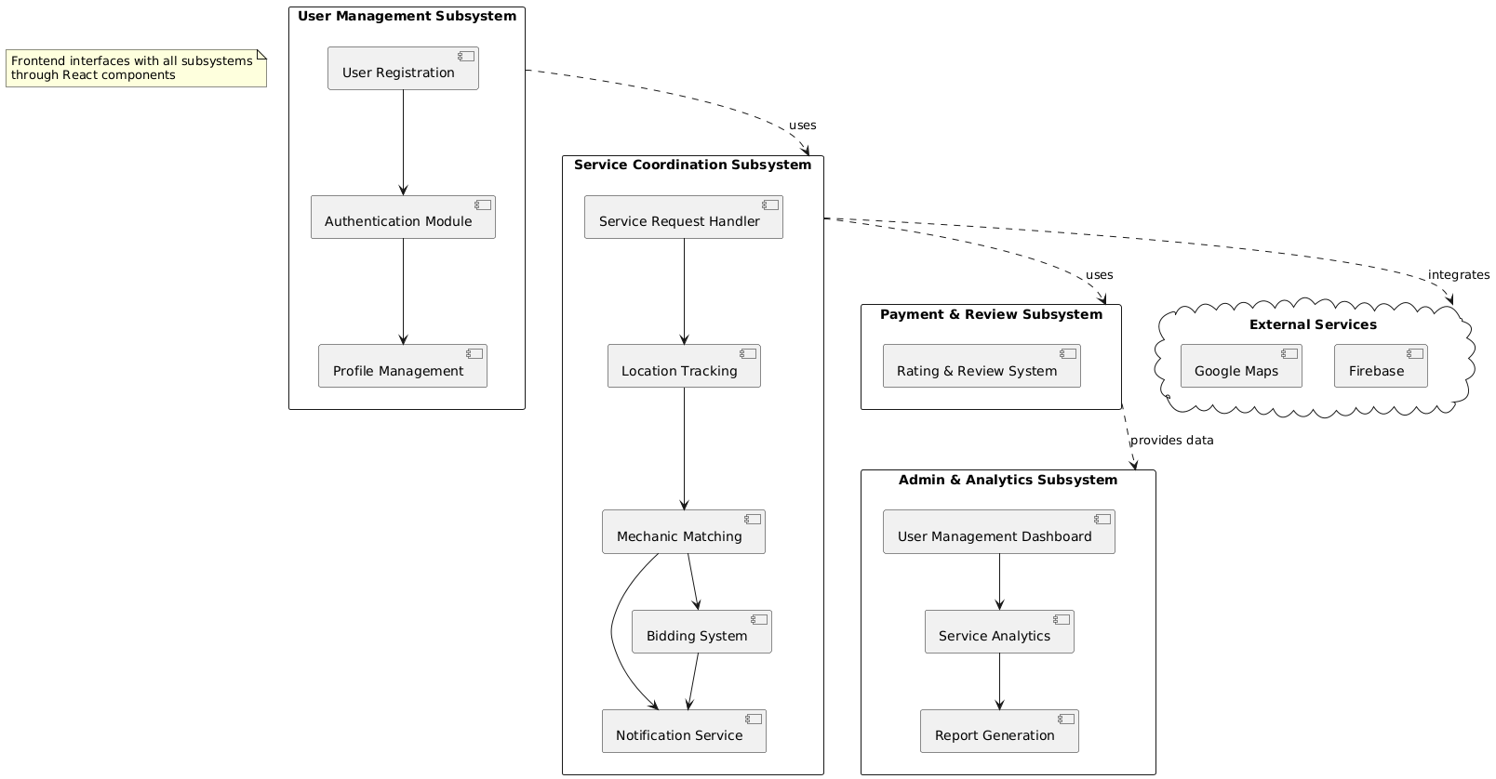
UML DIAGRAMS
Package Diagram

Slide 6
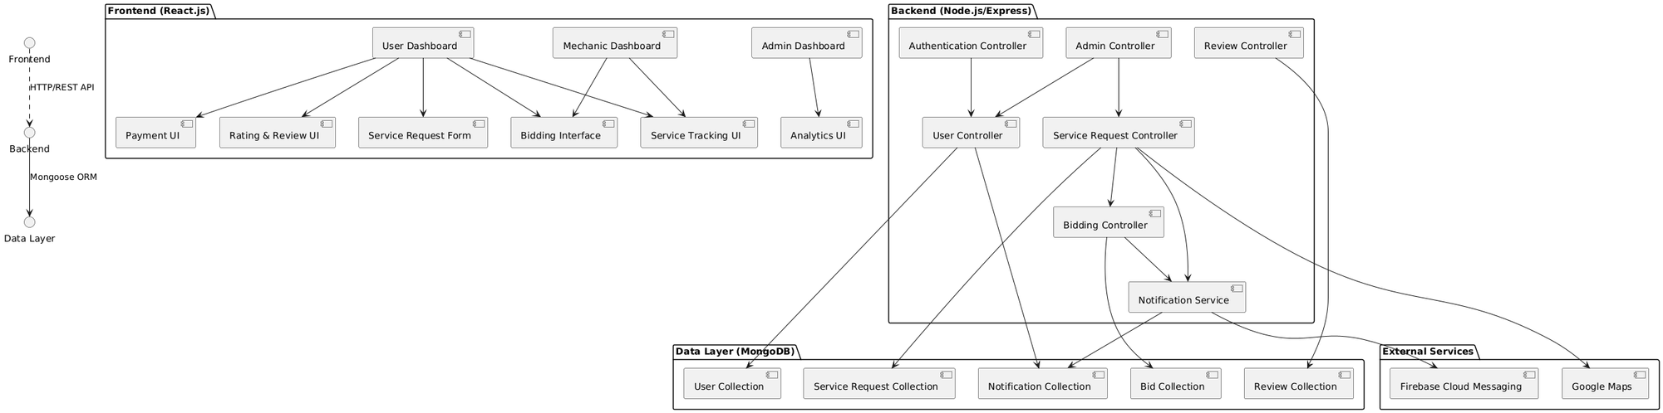
UML DIAGRAMS
Component Diagram

Slide 7
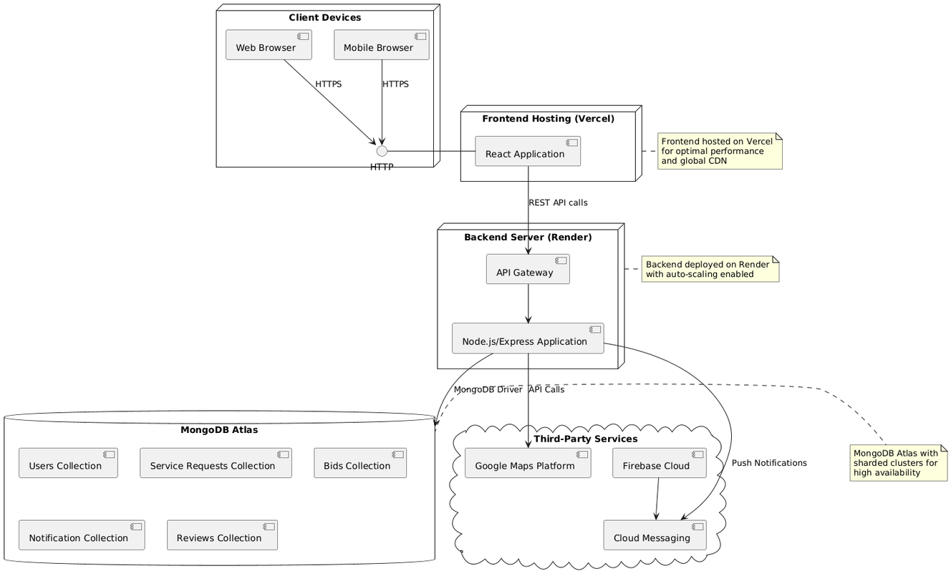
UML DIAGRAMS
Deployment Diagram

Slide 8
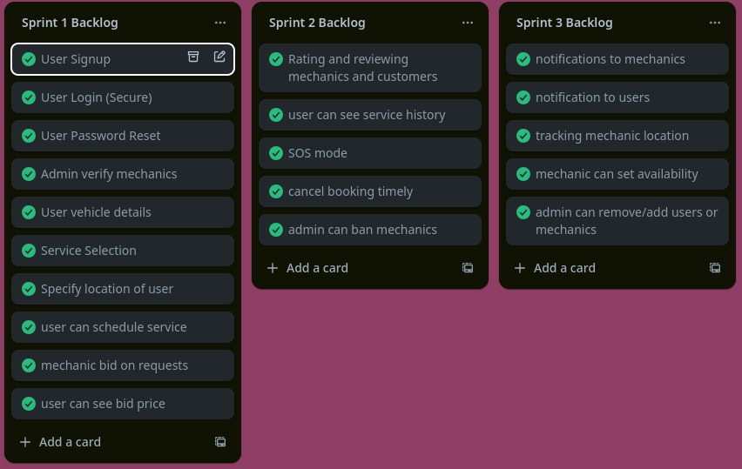
SPRINT PLANNING
www.reallygreatsite.com

Slide 9
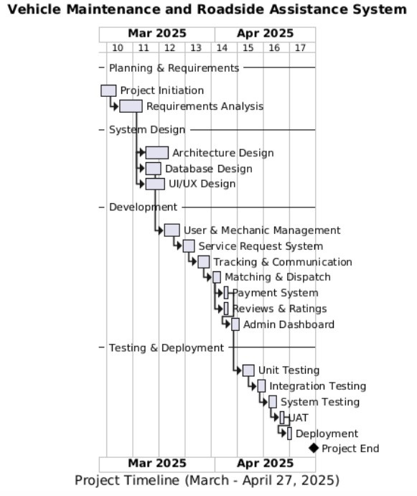
GANTT CHART
Development divided into 3 sprints completed over a course of 8 weeks
Gantt chart shows dependencies of tasks as well

Slide 10
USER STORIES
User Service Request Scheduling
The user selects a service type (e.g., Breakdown, Car Wash), enters location details, and schedules a request by specifying a preferred time and brief issue description.
Mechanic Bid Placing
Available mechanics view incoming service requests in their vicinity and place bids with a proposed amount and message explaining their offer.
User Bid Accepting
The user reviews all received bids, compares prices and mechanic ratings, and accepts the most suitable offer to initiate the service.
Service Tracking
Once a bid is accepted, the user can track the mechanic’s real-time location, receive live updates, and monitor job status from dispatch to completion.

Slide 11
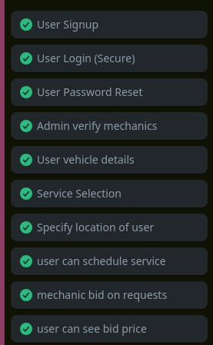
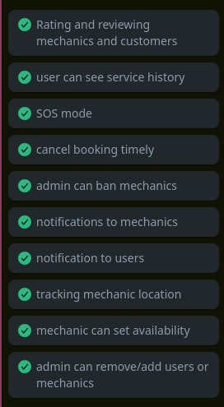
PRODUCT BACKLOG
www.reallygreatsite.com

Slide 12
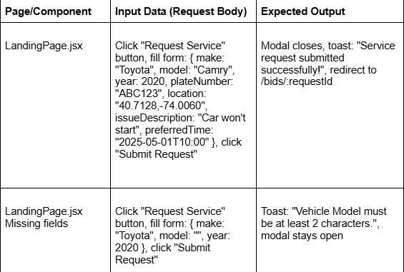
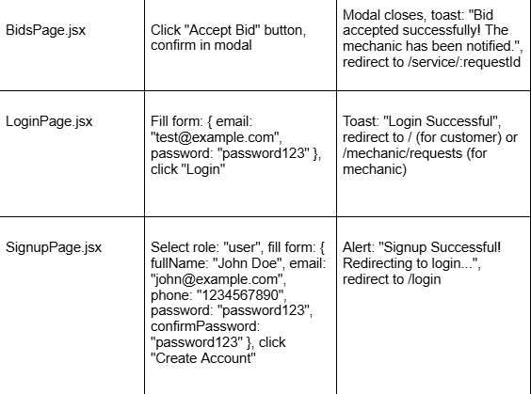
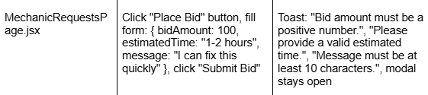
BLACK BOX TESTING

Slide 13
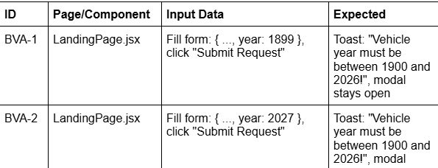
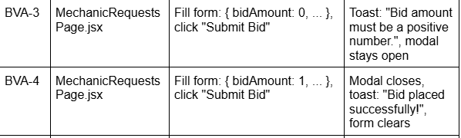
BOUNDARY VALUE ANALYSIS

Slide 14
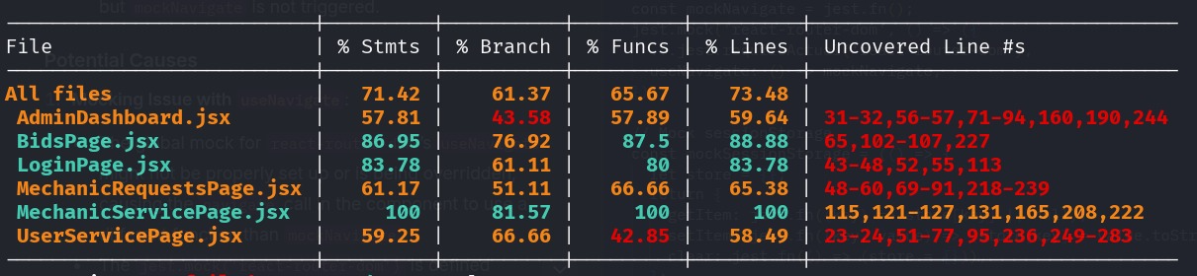
WHITE BOX TESTING
Achieved an overall test coverage of 73.48% across all files, with high function and line coverage in critical components like BidsPage.jsx (88.88%) and MechanicServicePage.jsx (100%).
Tools like Jest and React Testing Library were used to test core logic, navigation, and user interactions. Future work will target low-covered files such as UserServicePage.jsx and AdminDashboard.jsx to improve reliability.

Slide 15
AI-based Mechanic Dispatch: Use machine learning to auto-match requests with mechanics based on expertise, location, and response history.
Integrated Payment Gateway: Add real-time payment support via Stripe, JazzCash, or EasyPaisa
Push Notifications: Mobile alerts for booking status, mechanic arrival, or emergency updates.
Mechanic Tracking: Real-time GPS tracking of the assigned mechanic en route.
Feedback Moderation: Automatic spam and inappropriate content detection in reviews.
FURTHUR IMPROVEMETS

Slide 16
Technical Growth:
Learned full-stack development (React, Node.js, PostgreSQL)
Implemented RESTful APIs, JWT authentication, and third-party service integration.
Problem-Solving:
Tackled real-world challenges like location accuracy, request queuing, and error handling.
Team Collaboration:
Gained experience in version control (Git), task management, and agile development (sprints, stand-ups).
Software Engineering Practice:
Applied principles of modular design, testing strategies, and software architecture (3-tier model).
KEY LEARNINGS

Slide 17
CONCLUSION
We successfully developed a functional vehicle support platform that connects users with nearby mechanics, car wash providers, and maintenance experts.
The project highlighted the importance of usability, modular architecture, and user feedback integration in product design
.
As a team, we improved our collaboration, design thinking, and deployment skills — preparing us for future industry-level challenges.

Slide 18
THANK YOU

